Slide 1
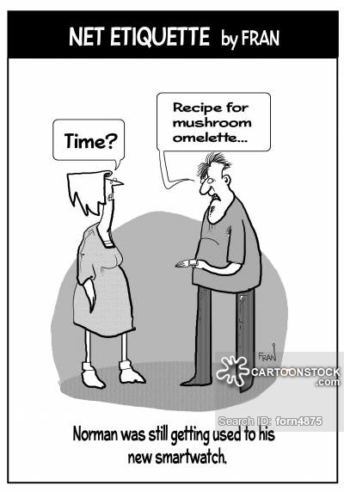
..
Interacting Beyond The Smartwatch Display Using Motion Tracking Technologies
Investigating user performance and usability for off-screen mid-air pointing on smartwatches.
Tudor-Stefan Dragan
Department of Computer Science
Copenhagen 2017

Slide 2
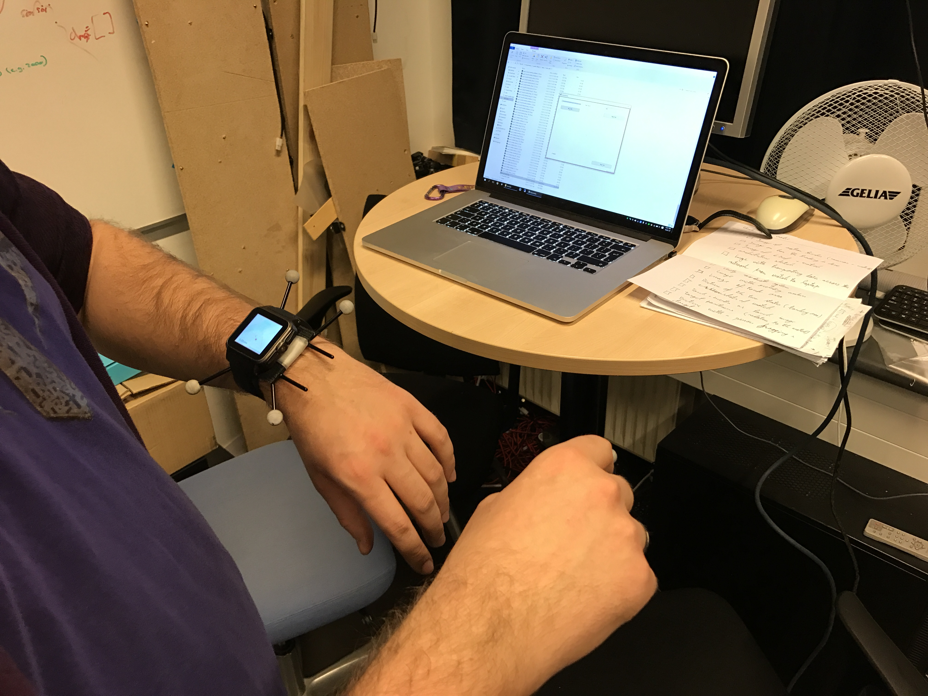
Introduction
Defining beyond display interaction
New and unexplored territory*
Problem area
View size
Fat finger problem
Occluding the interface
Touch input on small screen
*for smartwatches at least...

Slide 3
Objectives
To investigate the effectiveness of off-screen mid-air pointing for smartwatches.
To describe in detail the development of the mid-air tracker, the prototype used in the user study, as well as the results and guidelines for future development.

Slide 4
What did other researchers do?

Slide 5
Interaction Technologies
Off-screen Interaction Task
User Interfaces

Slide 6
Interaction Technologies
Off-screen Interaction Task
User Interfaces

Slide 7
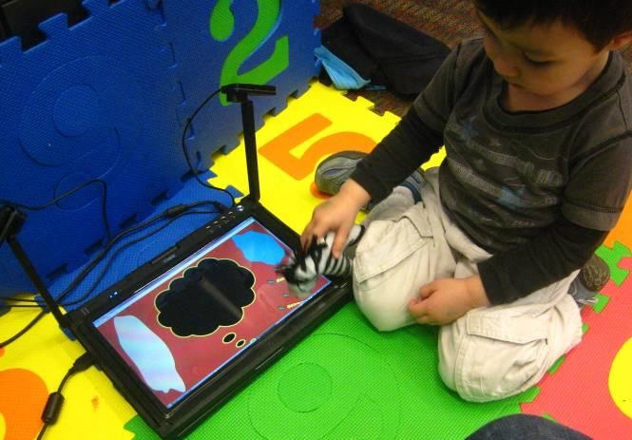
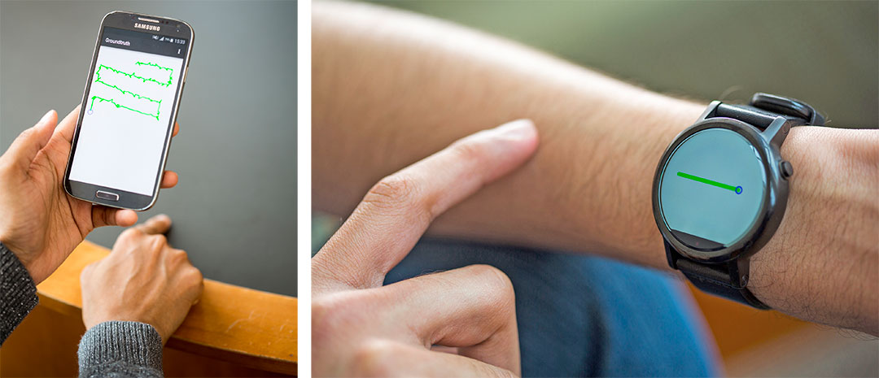
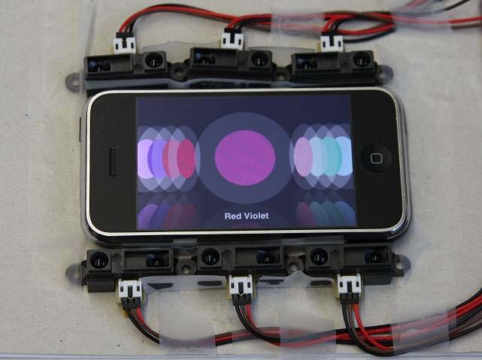
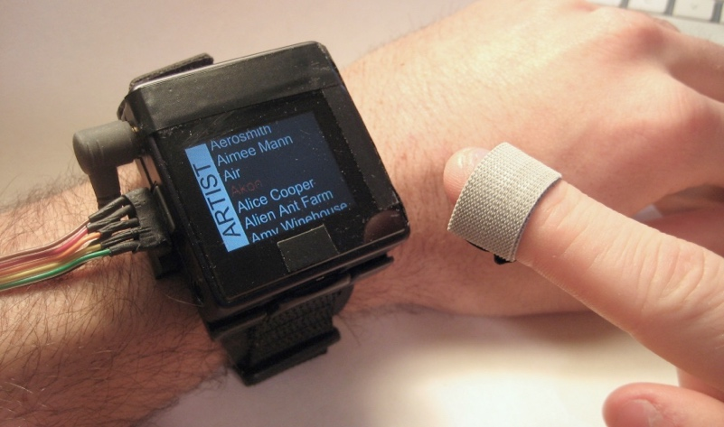
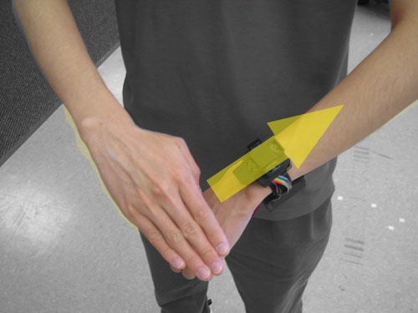
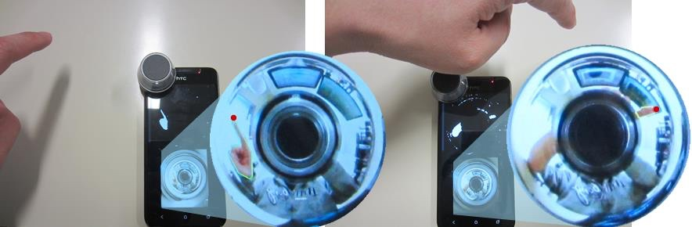
Internal and external sensors

Slide 8
Hmm... So many options...

Slide 9
No extra sensors in the prototype

Slide 10
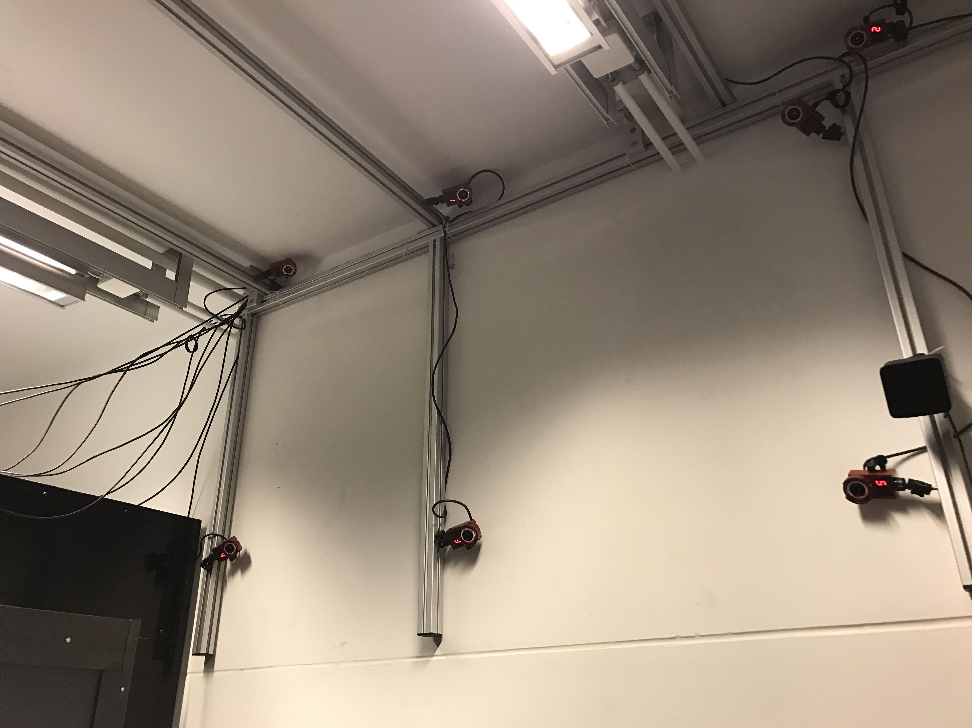
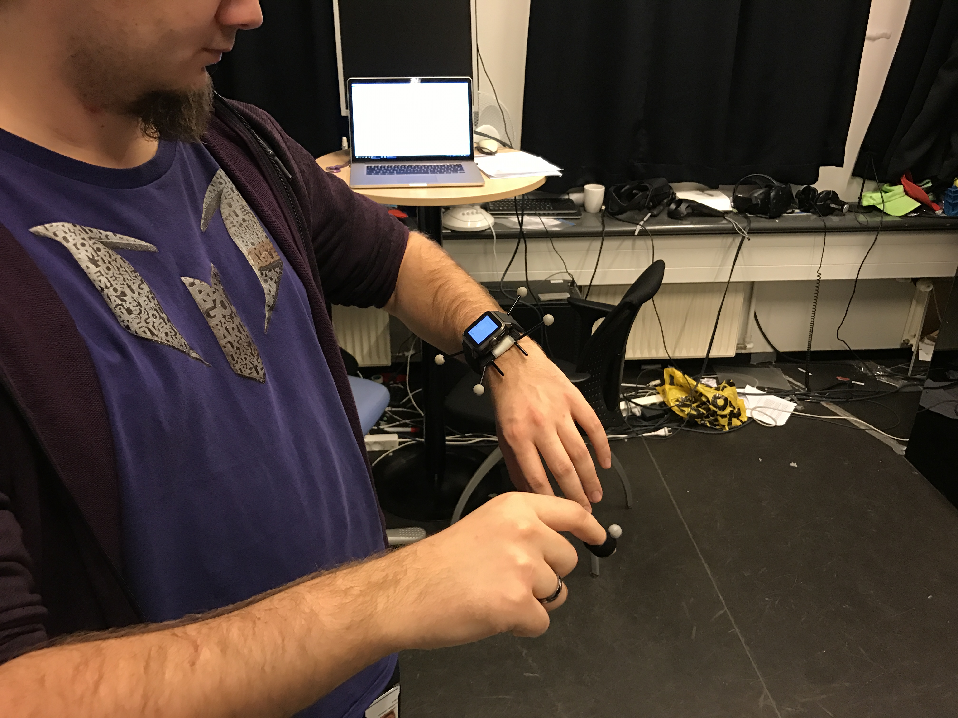
Mid-air pointing to the rescue
Passive motion tracking

Slide 11
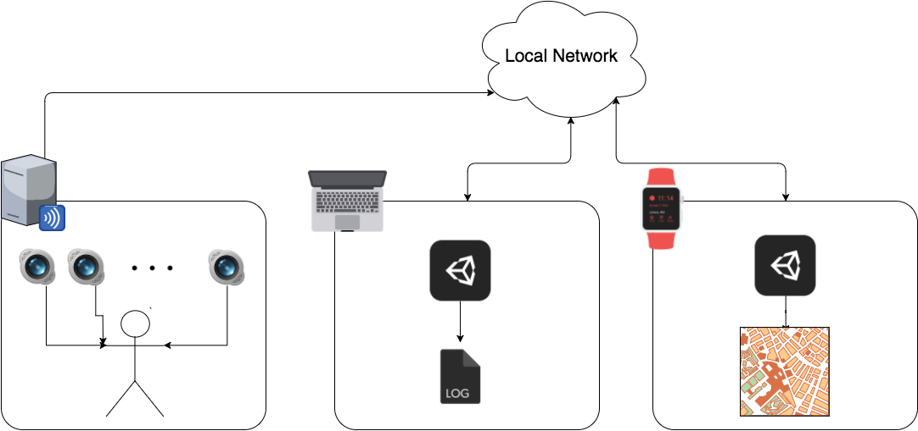
Architecture

Slide 12
Interaction Technologies
Off-screen Interaction Task
User Interfaces

Slide 13
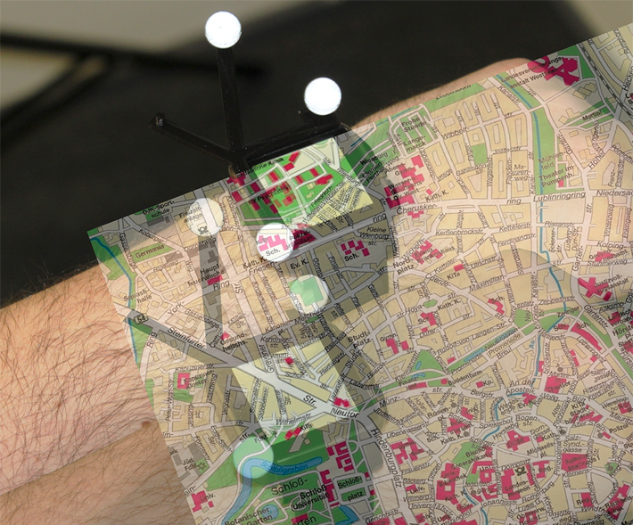
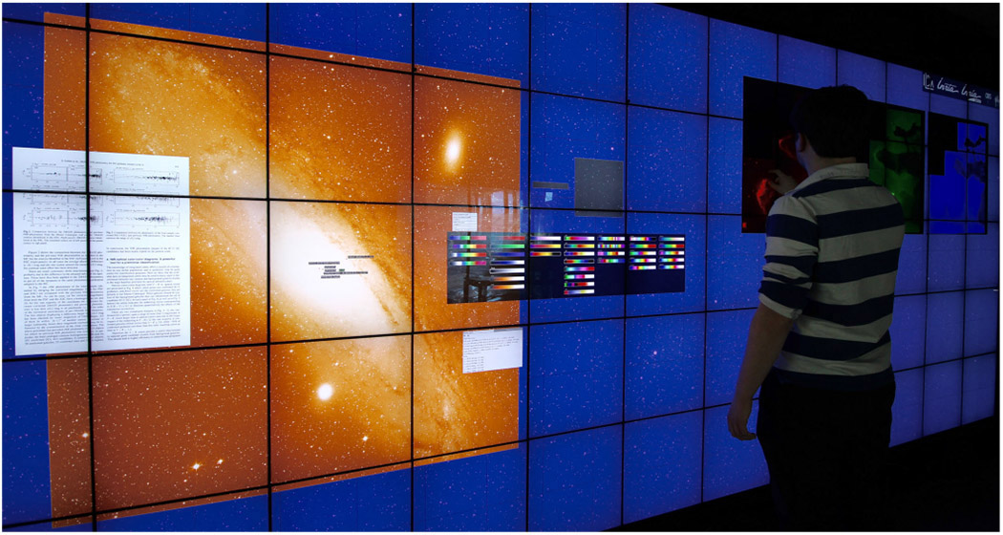
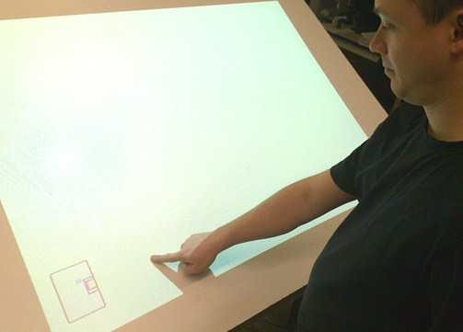
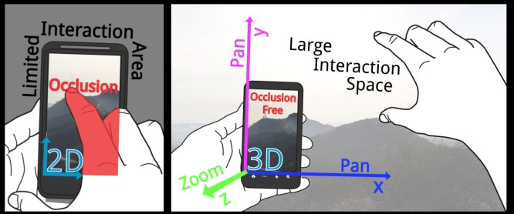
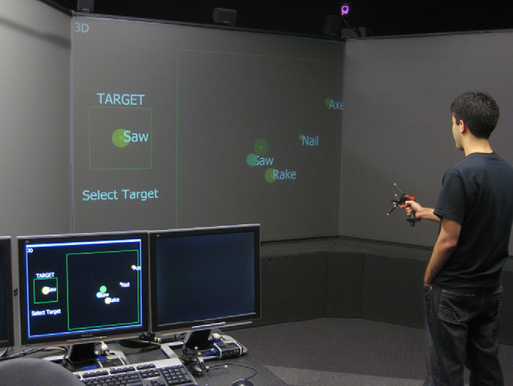
Off-screen interaction

Slide 14
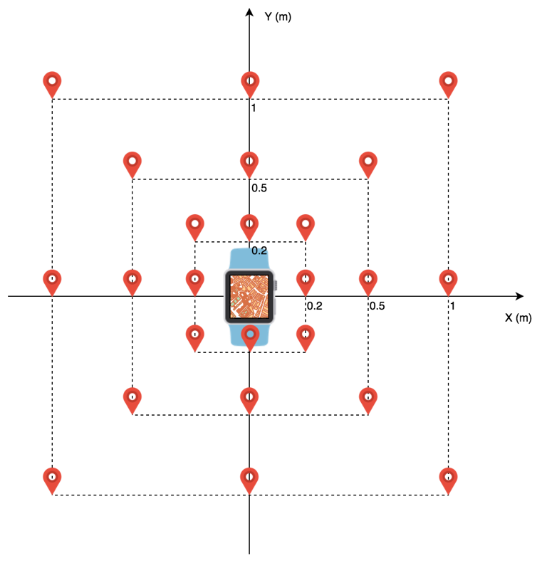
Experimental task

Slide 15
Interaction Technologies
Off-screen Interaction Task
User Interfaces

Slide 16
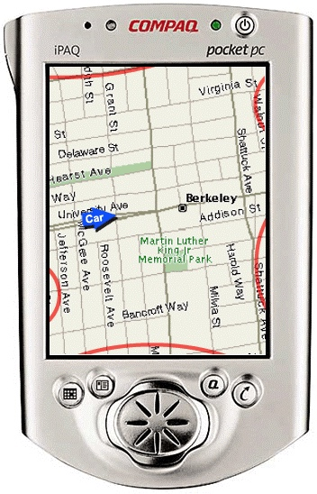
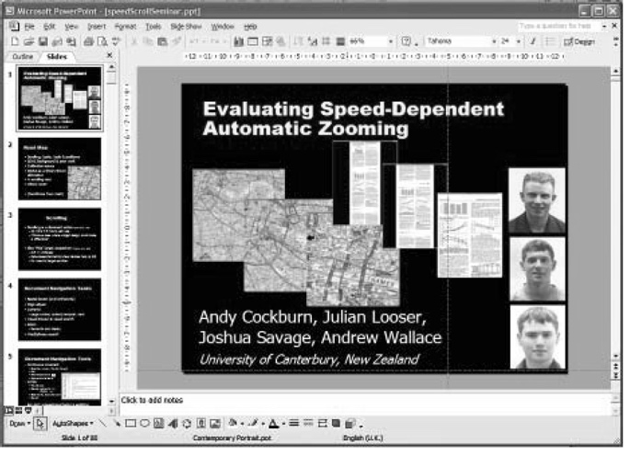
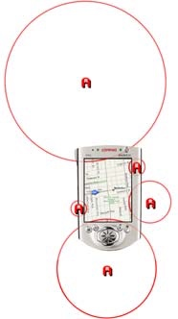
Choosing the proper UI
Cue-based navigation

Slide 17
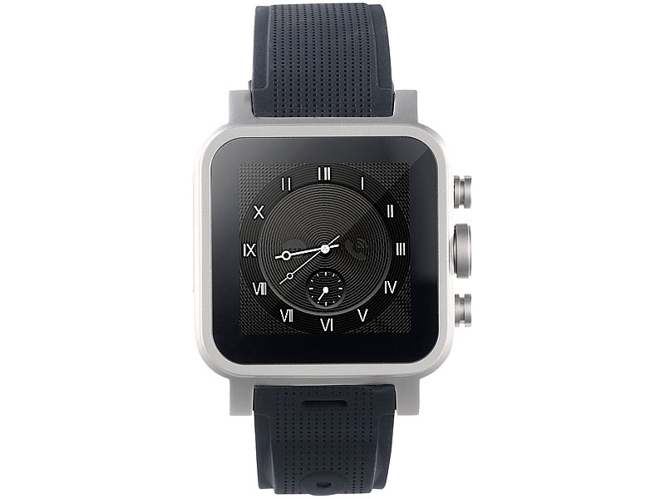
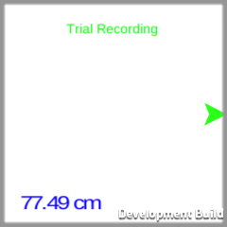
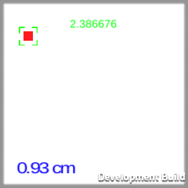
Choosing the proper UI
Cue-based navigation
Notes:
NEXT SLIDE: Because I was investigating the performance of mid air pointing for smartwatches I decided that…

Slide 18
Hypotheses & Results

Slide 19
Hypothesis 1 (H1)
By having a larger area of input, I expect that the trial times will improve significantly by using the Off-screen air pointing method.
Users will be able to complete the same tasks faster by having the ability to interact with a much larger input area.
Notes:
By having a larger area of input, I expect that the trial times will improve significantly by using the Off-screen air pointing method. Users will be able to complete the same tasks faster by having the ability to interact with a much larger input area.

Slide 20
Hypothesis 1 (H1) – Trial times
Started out with an initial model:
Y_{model4} =
trial_typeⅹtarget_distance +
trial_typeⅹdirection_axis +
task_number +
user_id_{random effect}
Ended up with:
Y_{final} =
trial_type +
target_distance +
direction_axis +
user_id_{random effect}
Notes:
Because I expected more variables than just the interaction method to have an effect on the number of clutches In order to identify the right model I used the backwards elimination method which means starting out with all candidate variables, and testing if the removal of each variable using a chosen model fit criterion. The main idea is to delete step-by-step the variables that do not provide a statistically significant loss of fit to the model.

Slide 21
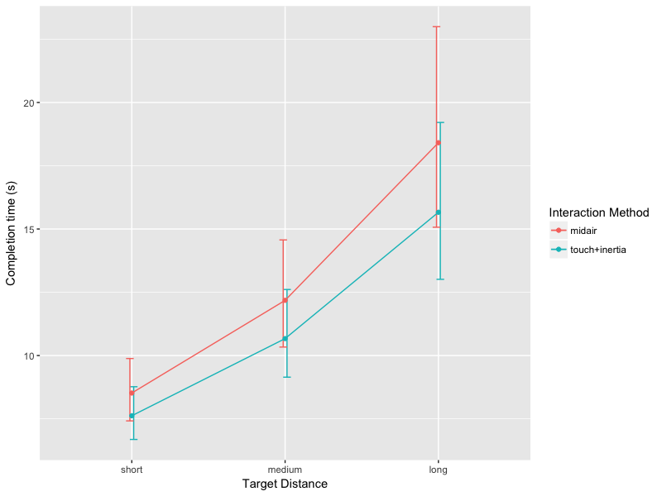
Hypothesis 1 (H1) – Trial times
Pairwise comparisons revealed that touch+inertia was faster than off-screen mid-air pointing interaction method, which means that Hypothesis 1 (H1) is false.
Overall, touch+inertia was faster
μ_{short}=7.620
μ_{medium}=10.669
μ_{long}=15.661
mid-air pointing.
μ_{short}=8.518,
μ_{medium}=12.181
μ_{long}=18.409

Slide 22
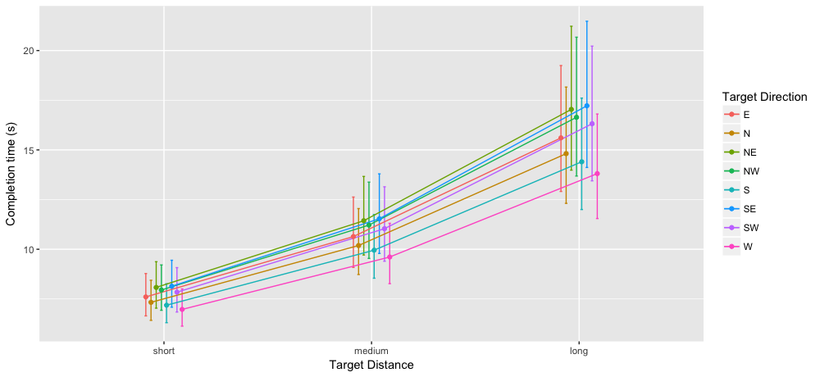
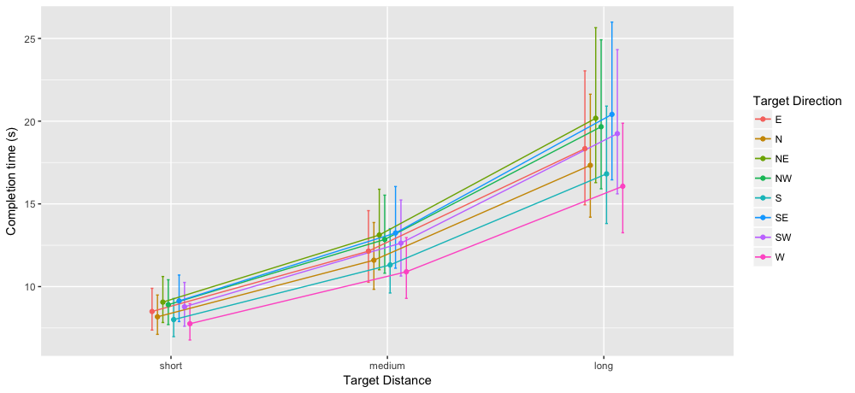
Hypothesis 1 (H1) – Trial times (stratified by direction)
touch+inertia
mid-air pointing
Notes:
When stratifying the model according to the targets initial direction we can see that the directions have the same order on the graph for the touch+inertia and mid-air interaction methods. That is because no statistical significant difference has been found when testing the interaction between the direction and interaction method. Some of the directions were significant from each other, but I decided not to include them in the analysis.

Slide 23
Hypothesis 2 (H2)
Off-screen air pointing will have less number of clutches for completing the task.
By giving the user more space for maneuvering the view port, he/she will need less clutch/release interactions.
Notes:
Off-screen air pointing will have less number of clutches for completing the task. By giving the user more space for maneuvering the view port, he/she will need less clutch/release interactions.

Slide 24
Hypothesis 2 (H2) – Number of interactions
Started out with the same initial model:
Y_{model4} =
trial_typeⅹtarget_distance +
trial_typeⅹdirection_axis +
task_number +
user_id_{random effect}
Ended up with:
Y_{final} =
trial_type +
target_distance +
user_id_{random effect}
Notes:
For finding the model for the number of interactions, I used the same approach as the one used in establishing the model for completion times. I started out by including all variables in my initial model. The initial formula describing both the fixed-effects and random effects part of the model with can be seen on the left.

Slide 25
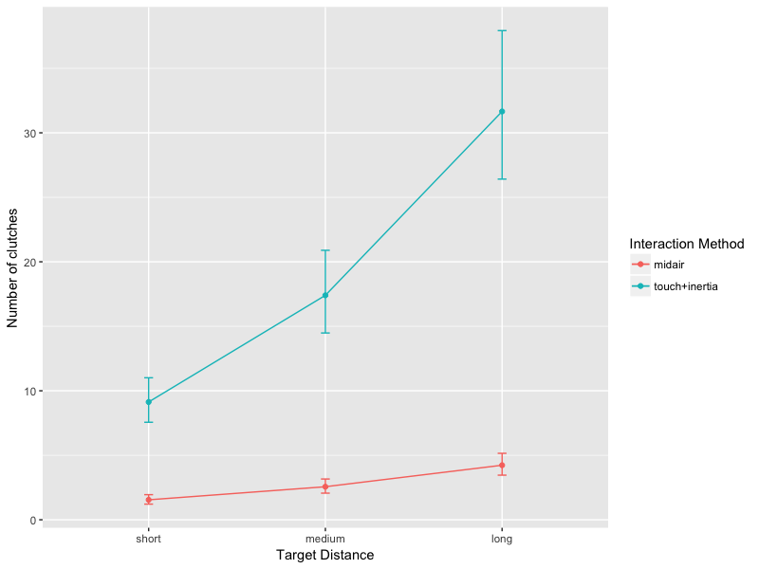
Hypothesis 2 (H2) – Number of Interactions
We can clearly see that there is a difference between interaction methods, thus Hypothesis 2 (H2) is supported.
Overall, touch+inertia required most operations
μ_{short}=9.1
μ_{medium}=17.4
μ_{long}=31.6
mid-air pointing.
μ_{short}=1.5
μ_{medium}=2.5
μ_{long}= 4.2
Notes:
The significant effect of target distance was unsurprising, as further targets require the use of more dragging operations. In Figure 21 we can clearly see that there is a difference between interaction methods (p<0.001), thus Hypothesis 2 (H2), which stated that off-screen mid-air pointing will have less number of clutches for completing the task than touch+inertia, is true. By giving the user more space for maneuvering the view port, he/she will need less clutch/release interactions. Overall, touch+inertia required most operations(μ_{short}=9.131, μ_{medium}=17.401, μ_{long}=31.655 ) when comparing with the mid-air pointing method(μ_{short}=1.547, μ_{medium}=2.563, μ_{long}= 4.230).

Slide 26
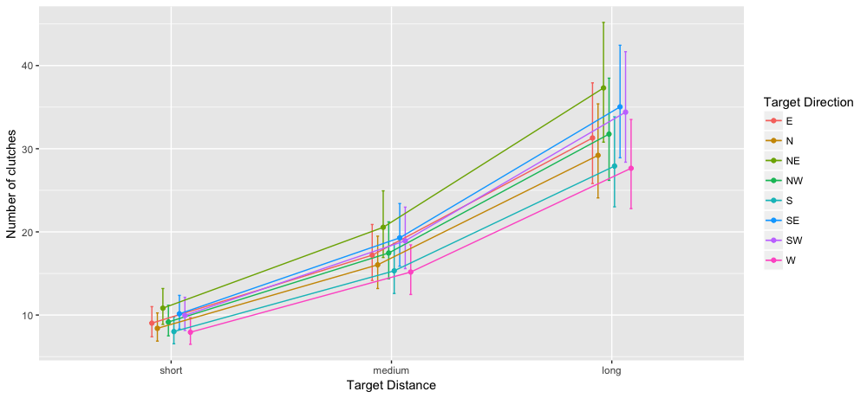
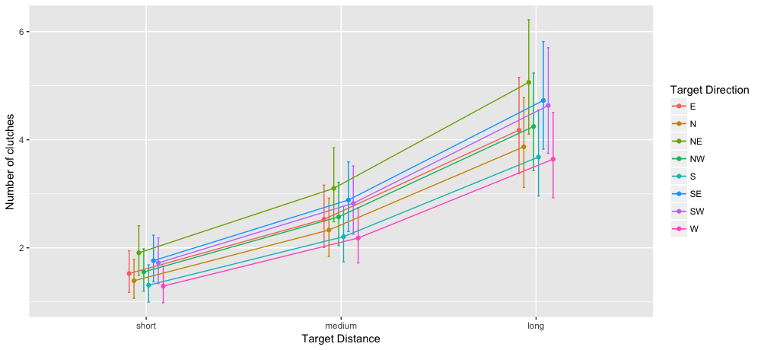
Hypothesis 2 (H2) – Number of interactions (stratified by direction)
touch+inertia
mid-air pointing
Notes:
When stratifying the model according to the targets initial direction we can see that the directions have the same order on the graph for the touch+inertia and mid-air interaction methods. That is because no statistical significant difference was found when testing for an interaction between the direction and interaction method. Some of the directions were significantly different from each other, and I have included the p-values in Appendix C.1. I did not perform a detail analysis here, because I considered it to be out of the current scope of this thesis.

Slide 27
Hypothesis 3 (H3)
Off-screen pointing will be less fatiguing than traditional touch.
Notes:
Off-screen pointing will be less fatiguing than traditional touch.

Slide 28
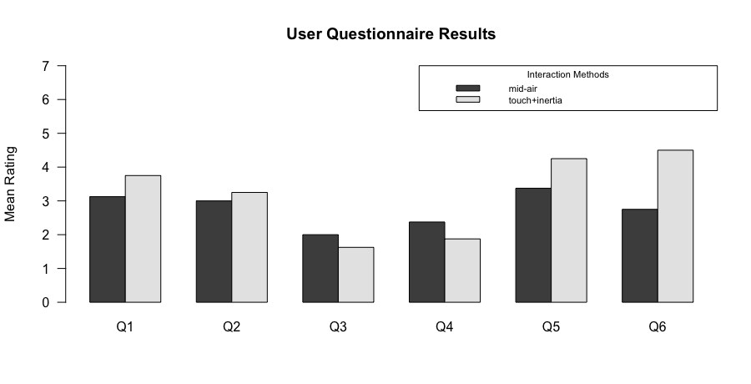
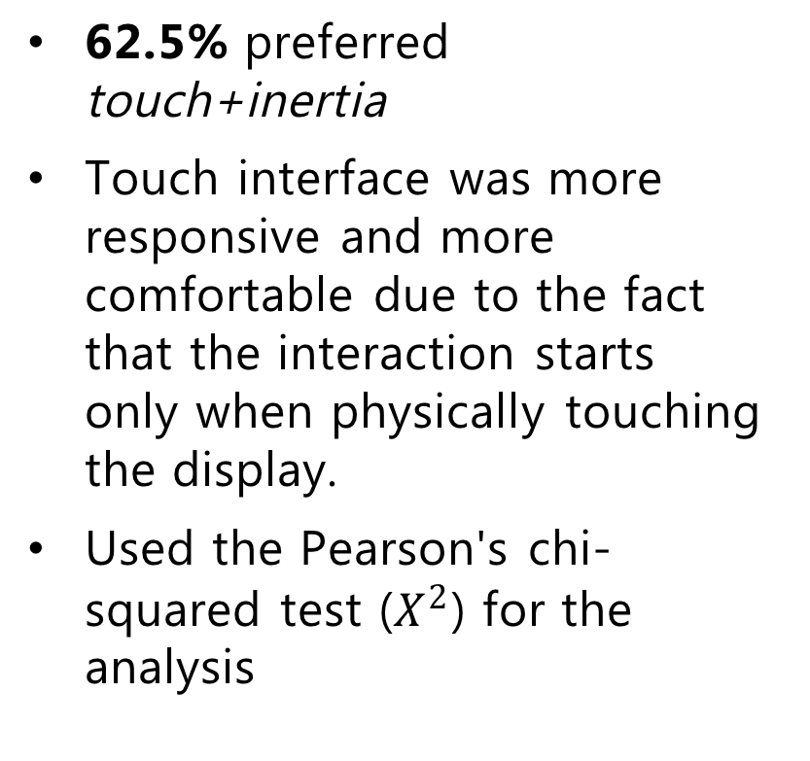
Hypothesis 3 (H3) – Questionnaire analysis
62.5% preferred touch+inertia
Touch interface was more responsive and more comfortable due to the fact that the interaction starts only when physically touching the display.
Used the Pearson's chi-squared test ($X^{2}$) for the analysis
Abbreviation | Question | Rating
Q1 | Smoothness during operation | 1 (Very rough) – 5 (Very smooth)
Q2 | Operation speed | 1 (Too fast) – 5 (Too slow)
Q3 | Finger fatigue | 1 (None) – 5 (Very high)
Q4 | Wrist fatigue | 1 (None) – 5 (Very high)
Q5 | General comfort | 1 (Very uncomfortable) – 5 (Very comfortable)
Q6 | Overall, the input method was | 1 (Very difficult to use) – 5 (Very easy to use)
Notes:
The participants were asked to fill out a questionnaire after finishing both interaction experiments. In the last part of the questionnaire the users had to give an overall subjective ranking on which interaction method was better. After collecting the results, 62.5% preferred touch+inertia over the md-air pointing technique. When looking through the feedback that the users provided, I noticed that multiple people have stated that it felt that the touch interface was more responsive and more comfortable due to the fact that the interaction starts only when physically touching the display, whether as in the mid-air technique, moving your arm by mistake would trigger unintentional interactions on the smartwatch. For each technique, a set of questions have been selected to give an idea on how each input method performed, in terms of user satisfaction and ease of use. An overview of the questions can be seen in the table below as well as in the Appendix A.

Slide 29
Hypothesis 3 (H3) – Questionnaire analysis
For Q1-Q5 there is no statically significant difference between the two interaction methods.
Question Q6 is the only one that showed a statistical significant difference in favor of the touch+inertia interaction method.
Abbreviation | Question | Rating
Q1 | Smoothness during operation | 1 (Very rough) – 5 (Very smooth)
Q2 | Operation speed | 1 (Too fast) – 5 (Too slow)
Q3 | Finger fatigue | 1 (None) – 5 (Very high)
Q4 | Wrist fatigue | 1 (None) – 5 (Very high)
Q5 | General comfort | 1 (Very uncomfortable) – 5 (Very comfortable)
Q6 | Overall, the input method was | 1 (Very difficult to use) – 5 (Very easy to use)
Notes:
My tests show that for questions Q1(p=0.064), Q2(p=0.513), Q3(p=0.766), Q4(p=0.391) and Q5(p=0.276) there is no statically significant difference between the two interaction methods. Question Q6(p=0.021) is the only one that showed a statistical significant difference in favor of the touch+inertia interaction method. Even though the mean ratings for questions Q3(μ_{mid-air}=2, μ_{touch+inertia}=1.625) and Q4(μ_{mid-air}=2.375, μ_{touch+inertia}=1.875) are favorable towards the off-screen interaction method, the Hypothesis 3 (H3), which states that off-screen mid-air pointing will be less fatiguing than the traditional touch input, is rejected. Nevertheless, my data suggests that touch+inertia performed better in regards to the overall ease of use compared to mid-air pointing. Overall, touch+inertia performed better than mid-air pointing across the board.

Slide 30
Hypothesis 3 (H3) – Questionnaire analysis
Even though the mean ratings for questions
Q3
μ_{mid-air}=2,
μ_{touch+inertia}=1.625
Q4
μ_{mid-air}=2.375
μ_{touch+inertia}=1.875
are favorable towards the off-screen interaction method, the Hypothesis 3 (H3) is rejected.
Abbreviation | Question | Rating
Q1 | Smoothness during operation | 1 (Very rough) – 5 (Very smooth)
Q2 | Operation speed | 1 (Too fast) – 5 (Too slow)
Q3 | Finger fatigue | 1 (None) – 5 (Very high)
Q4 | Wrist fatigue | 1 (None) – 5 (Very high)
Q5 | General comfort | 1 (Very uncomfortable) – 5 (Very comfortable)
Q6 | Overall, the input method was | 1 (Very difficult to use) – 5 (Very easy to use)
Notes:
My tests show that for questions Q1(p=0.064), Q2(p=0.513), Q3(p=0.766), Q4(p=0.391) and Q5(p=0.276) there is no statically significant difference between the two interaction methods. Question Q6(p=0.021) is the only one that showed a statistical significant difference in favor of the touch+inertia interaction method. Even though the mean ratings for questions Q3(μ_{mid-air}=2, μ_{touch+inertia}=1.625) and Q4(μ_{mid-air}=2.375, μ_{touch+inertia}=1.875) are favorable towards the off-screen interaction method, the Hypothesis 3 (H3), which states that off-screen mid-air pointing will be less fatiguing than the traditional touch input, is rejected. Nevertheless, my data suggests that touch+inertia performed better in regards to the overall ease of use compared to mid-air pointing. Overall, touch+inertia performed better than mid-air pointing across the board.

Slide 31
Additional user feedback – touch+inertia
Advantages
Intuitive, didn’t need to learn using it
More responsive
Significantly less input lag
Precise
Disadvantages
Could not see the target at times
The inertia wasn’t additive*
*actually it was :)
Notes:
Four out of eight participants reported that touch+inertia was very intuitive and required no learning in using it;

Slide 32
Additional user feedback – mid-air pointing
Advantages
Very useful for targets located at a far distance
Intuitive to use, although they “wouldn’t use it on a bus”
One user moved the wrist with the smartwatch with the pointing finger towards each other in the same time.
Disadvantages
Difficult to “guess” the clutching area.
Covering some of the screen with the pointing finger
Notes:
They had a hard time entering and leaving the interaction area, thus making it hard to control and complete their target acquisition task.

Slide 33

Limitations & Issues
Notes:
During the prototype’s development I have stumbled upon different issues and inconveniences that impacted the final results. Some of these issues I have managed to solve, but others could not be fixed. I will be talking about the problems that have an impact on the system’s performance, accuracy and usability and could not be fixed or removed entirely. Important here to note is that I have tried to come up with different workarounds and solutions to minimize the impact on the final results of the experiments. Let’s start out with the most important one, in my opinion…

Slide 34
No repeated measurements
I consider this misstep to have a major impact in my results
I am unable to see if there is any learning involved for each participant
That being said, I also consider that by keeping the trials short (an average user would finish all tasks in about 25-35 min)
the participants felt less fatigued
more objective when answering the questionnaire.
Notes:
The most important, in my opinion, was the fact that I have not conducted repeated measurements per participant. By doing so I am unable to see if there is any learning involved for each user that could have a significant impact on completion times. That being said, I also consider that by keeping the trials short (an average user would finish all tasks in about 25-35 min) the participants felt less fatigued and would be more objective when answering the questionnaire.

Slide 35
Network lag
Notes:
Because of the system is composed of 3 devices communicating in a daisy-chain structure through the local network (see Figure 11), it comes to no one’s surprise that there is a delay between the user’s arm movements and the interface updates on the smartwatch. This delay only affects the mid-air pointing task because the positions of the smartwatch and finger must be processed on the laptop and then streamed to the watch. Because this lag could not be avoided, I have tried to reduce the overall overhead by streaming the positions to the watch right after I have finished processing the data frame received from the OptiTrack server. When streaming, the packages that are being sent across the network are as small as possible (20 bytes per payload) on an unreliable channel, which means packages can be dropped and the watch only receives and processes the latest scene state.

Slide 36
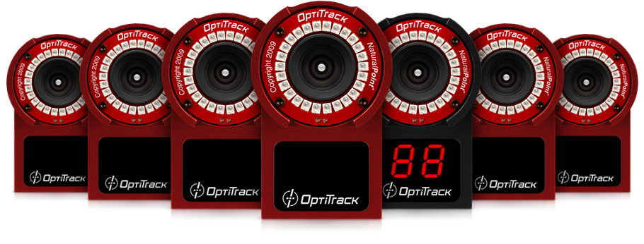
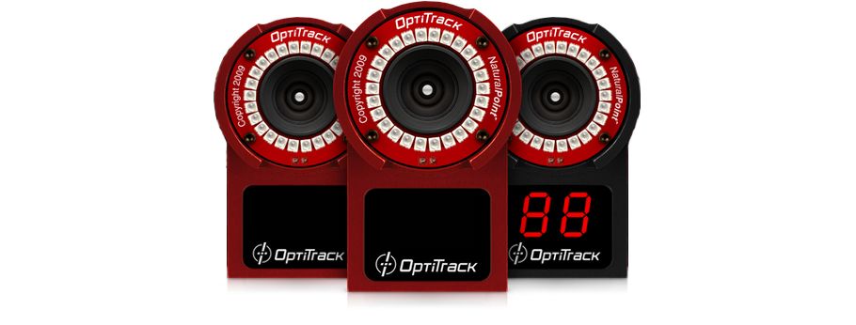
Motive accuracy problems
Ideally
24 cameras
Working
12 cameras
Notes:
The OptiTrack setup, that I have used, had only 12 functional cameras (out of 24) and severely impacted the performance of my system. The entire system became very sensitive to other objects in the room that might have been mistaken for reflective markers. Because I am tracking the finger’s position with only one marker that is attached on the user’s fingernail, the probability of that marker to be occluded or mistaken for some other object in the room was very high. The tracking of the smartwatch, on the other hand, was less of a concern. It had been done using a fiber filled nylon plastic rigid base attached to the back of the smartwatch, between the device and the user’s wrist. Having 4 markers that represent the rigid body provides more reliable rigid body tracking and even if one or two markers are occluded, the software can predict the watch’s position without any problems. I tried minimizing the finger tracking issues with the algorithm that I have presented in an earlier subchapter.

Slide 37
Motive accuracy problems
Notes:
The OptiTrack setup, that I have used, had only 12 functional cameras (out of 24) and severely impacted the performance of my system. The entire system became very sensitive to other objects in the room that might have been mistaken for reflective markers. Because I am tracking the finger’s position with only one marker that is attached on the user’s fingernail, the probability of that marker to be occluded or mistaken for some other object in the room was very high. The tracking of the smartwatch, on the other hand, was less of a concern. It had been done using a fiber filled nylon plastic rigid base attached to the back of the smartwatch, between the device and the user’s wrist. Having 4 markers that represent the rigid body provides more reliable rigid body tracking and even if one or two markers are occluded, the software can predict the watch’s position without any problems. I tried minimizing the finger tracking issues with the algorithm that I have presented in an earlier subchapter.

Slide 38
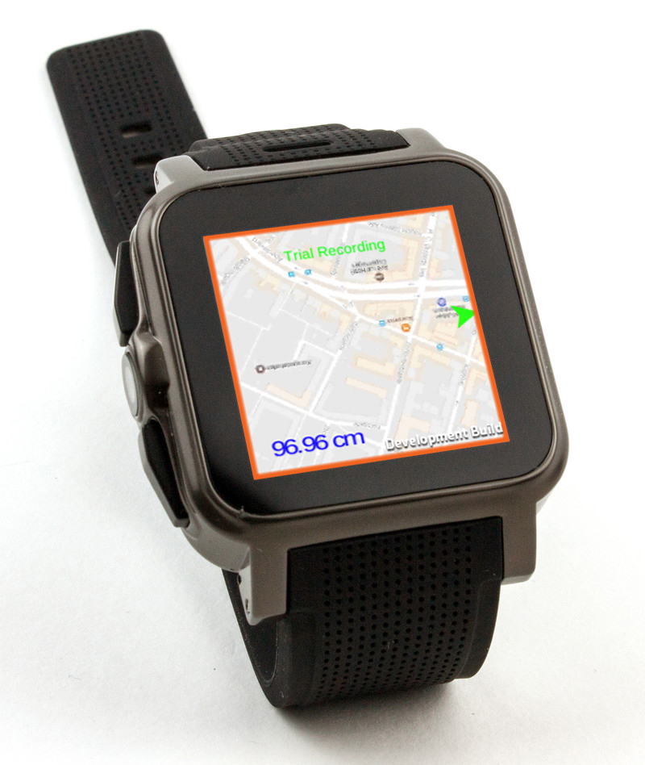
Smartwatch’s left and right touch areas
Notes:
The task that required the user to pan directly on the display (touch+inertia) had some imprecise data recordings due to the fact that the watch’s operating system reserved the left and right borders for system “call to“ actions. Thus, when swiping from outside the watch’s border, left or right, the touch motion wouldn’t register. When swiping from the bottom or from the top, the event did register and the user could manipulate the interface. This would mean that higher values in completion times should be expected when investigating the directions where the target had spawned initially. I will be investigating this in my analyses in a later chapter.

Slide 39
OptiTrack camera tracking noise

Slide 40
I had a problem with my sweater and boots, had to take them off because they were interfering with the cameras.
Anonymous participant

Slide 41
Future work

Slide 42
Improving the prototype
Working
12 cameras
You guessed it...
24 cameras
Notes:
As mentioned in a previous chapter, there were some problems in marker tracking. This would have been easily resolved by enabling the other 12 cameras in the room. During the experiments I had captured additional data that I haven’t used in my analysis. The log files contain positional data for the finger, smartwatch and target for each participant during the entire experiment. This data could provide some additional insights for future research into what off-screen area do people use the most.

Slide 43
Improving the prototype
Eliminating input lag
Remove the passive motion tracking system
Experiment with different shapes for triggering the pan gesture
Adding zoom and rotating features
More gestures for enabling different actions
Notes:
As mentioned in a previous chapter, there were some problems in marker tracking. This would have been easily resolved by enabling the other 12 cameras in the room. During the experiments I had captured additional data that I haven’t used in my analysis. The log files contain positional data for the finger, smartwatch and target for each participant during the entire experiment. This data could provide some additional insights for future research into what off-screen area do people use the most. The current prototype only works in a room with motion cameras and having reflective markers attached to the finger and the device. This approach decreases ease of use considerably and constrains the user to only use the system in an enclosed and controlled environment. As we have seen with one participant, the issue of reflective garments can disrupt the way the prototype works. Future work should focus on exchanging the current tracking technology with one that can perform equally or better than the ones presented in Chapter 2.4 when discussing related work.

Slide 44
Conclusion

Slide 45
Conclusion
The results showed that the mid-air interaction method performed worse in terms of completion times
There was no significant difference in fatigue ratings between mid-air and touch input.
Mid-air pointing turned out to use less interactions, mainly due to the fact that the user’s had a larger area of input.
Overall, the mid-air interaction did not perform better than touch and my recommendation would be that future work is needed for improving the current prototype.

Slide 46

Time for some questions

